Slide 1
Micron HFW treatment - Lab Testing Update

Slide 2
Objective of the Base Case Study
To evaluate the effectiveness of Fluoride precipitation using lime (Ca(OH)2) or calcium chloride (CaCl2) or its combination for fluoride containing wastewater

Slide 3
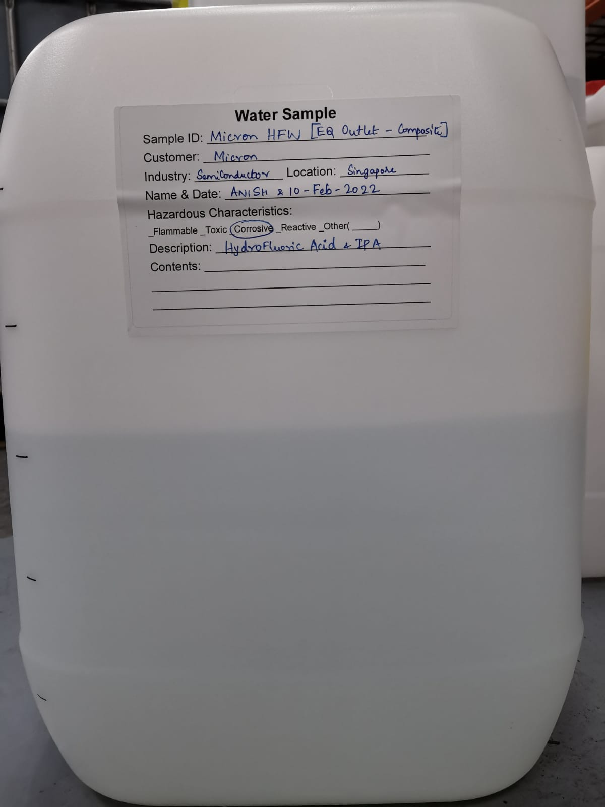
Feed collected on 10-Feb-2022 from HFW EQ Outlet Base Case Experiment 1 Scheme followed: - Jar Testing

Slide 4
Base case experiment 1
2 beakers of 500ml each of HFW feedwater is considered as Case 1 & Case 2
Once dosed, allow rapid mixing for 30s, & followed by Slow mixing for 45 min, measure pH every 10 min
Dose 1 mg/L of SNF polymer (anionic) for each jars and further slower mix (60 rpm) for 45 min. Measure pH every 30 min
Stop mixing and leave the solids to settle over 60 min, allow sludge settling
All supernatant was collected for analysis
Case 1 Dosage | Case 2 Dosage
2920 mg/L Ca(OH)2 | 800 mg/L Ca(OH)2 + 2350 mg/L CaCl2

Slide 5
Base case experiment 1: Jar testing
EC(uS/cm) |  |  | TDS/PPM |  | pH
Time | Jar 1 | Jar 2 | Jar 1 | Jar 2 | Jar 1 | Jar 2
16:00 | 7204 | 5208 | 3868 | 2753 | 11.9 | 8.72
16:15 | 7629 | 5208 | 4115 | 2753 | 11.9 | 8.5
16:30 | 7770 | 5221 | 4197 | 2760 | 12 | 8.5
16:45 | 7770 | 5198 | 4197 | 2748 | 11.77 | 8.32
17:00 | 7890 | 5181 | 4269 | 2739 | 11.97 | 8.4
17:20 | 7915 | 5217 | 4283 | 2759 | 11.93 | 8.46
17:40 | 7927 | 5029 | 4291 | 2656 | 12.1 | 8.98
Case 1 Dosage | Case 2 Dosage
2920 mg/L Ca(OH)2 | 800 mg/L Ca(OH)2 + 2350 mg/L CaCl2

Slide 6
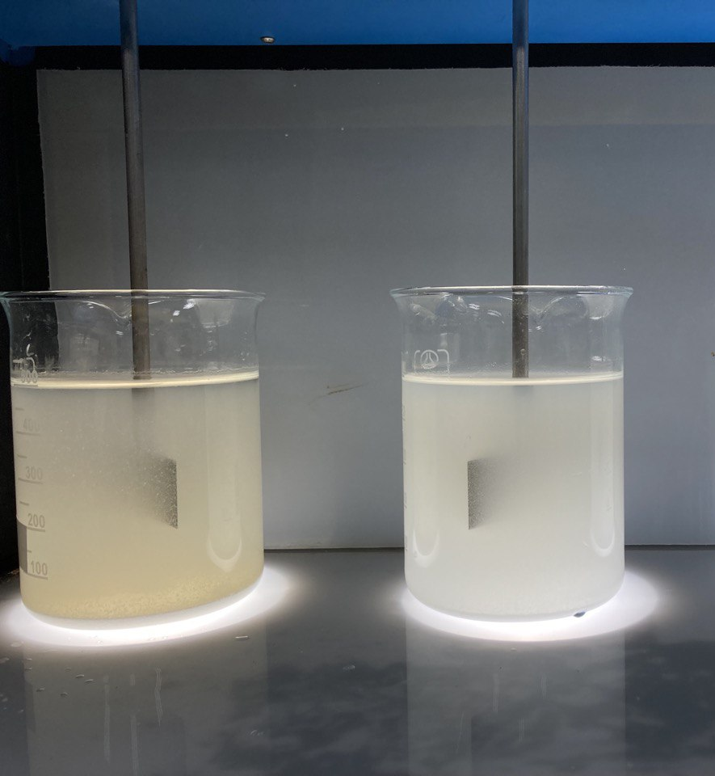
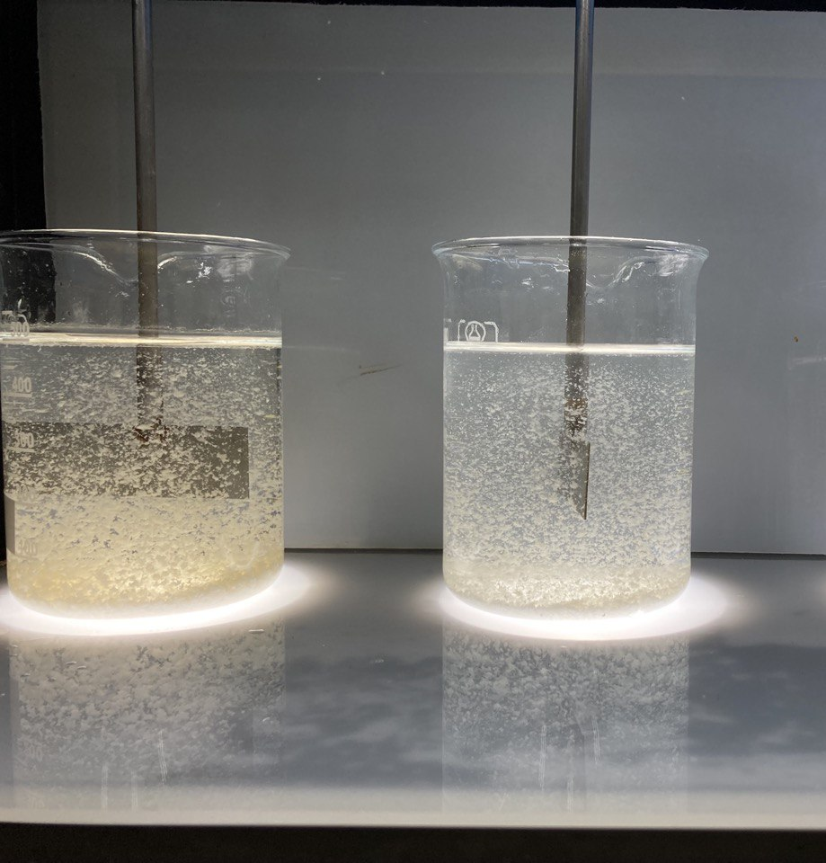
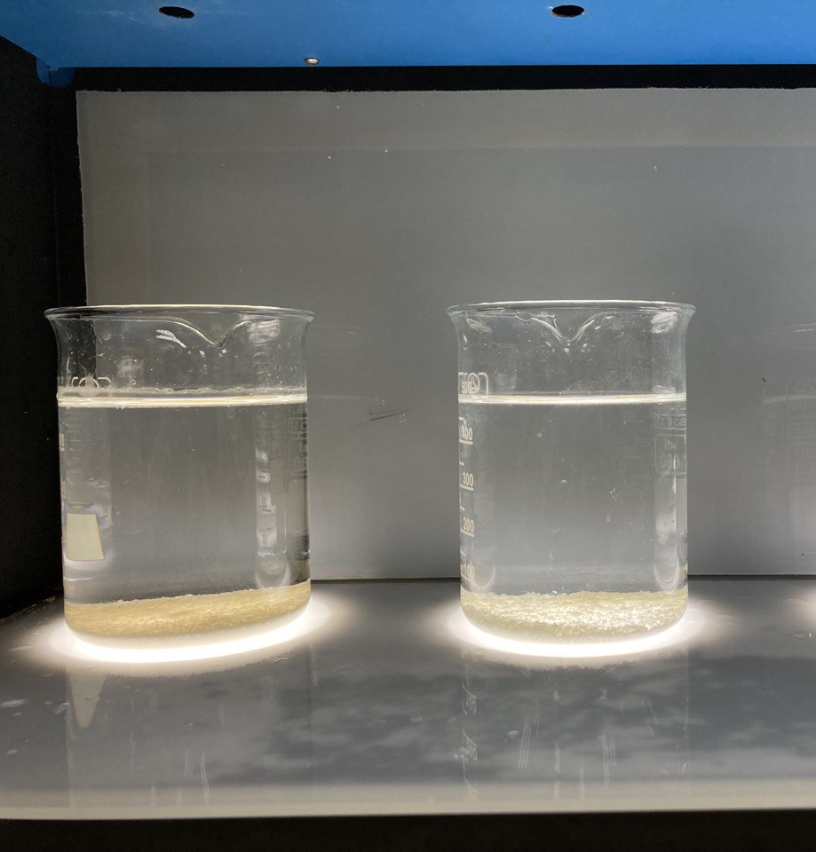
Jar Testing – Addition of chemicals
Addition of chemicals into different jars (Left: case 1, right: case 2)
Addition of 1 mg/L polymer into different jars (Left: case 1, right: case 2)
Sludge settling (Left: case 1, right: case 2)

Slide 7
Base case experiment 1- Jar testing treated water analysis
Parameters | Units | Feed | Case 1 | Case 2
pH | - | 2.95 | 12.1 | 8.98
TDS | ppm | 1302 | 4291 | 2656
EC | uS/cm | 2556 | 7927 | 5029
Fluoride as F | ppm | 372 | 9.02 | 7.02
Sulphate as SO4 | ppm | 310 | 256 | 275
Phosphate as PO4 | ppm | <1 | <1 | <1
Chloride as Cl | ppm | 72.4 | 59 | 1443
Sodium as Na | ppm | 263 | 279 | 288
Calcium as Ca | ppm | 1.15 | 627 | 685
Silicon as Si | ppm | 23.9 | 0.274 | 2.88
Total Alkalinity as CaCO3 | ppm |  | 1975 | 200
Inference: Fluoride is meeting the discharge specification
Case 1 Dosage | Case 2 Dosage
2920 mg/L Ca(OH)2 | 800 mg/L Ca(OH)2 + 2350 mg/L CaCl2

Slide 8
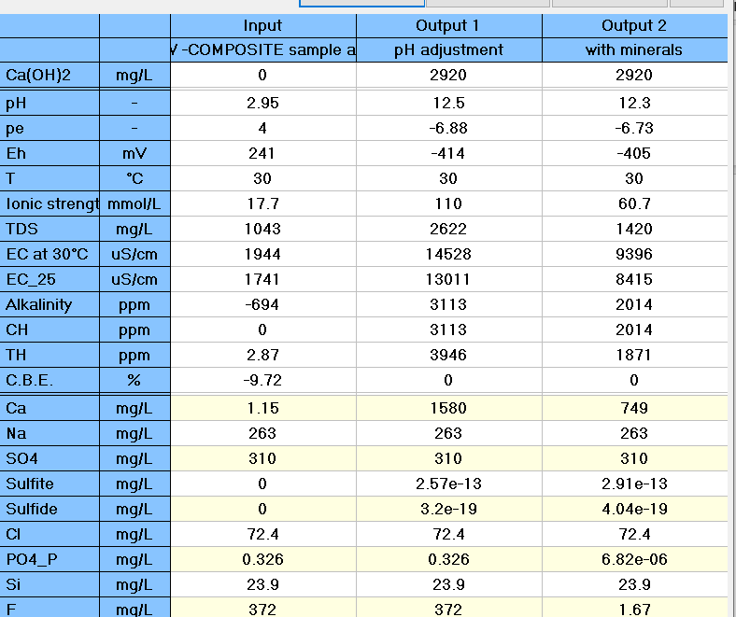
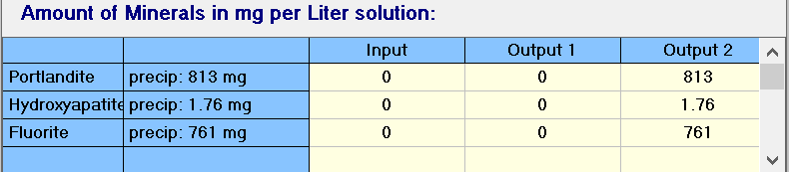
Lime only – Lab test vs simulation
Parameters | Units | Feed | Case 1
pH | - | 2.95 | 12.1
TDS | ppm | 1302 | 4291
EC | uS/cm | 2556 | 7927
Fluoride as F | ppm | 372 | 9.02
Sulphate as SO4 | ppm | 310 | 256
Phosphate as PO4 | ppm | <1 | <1
Chloride as Cl | ppm | 72.4 | 59
Sodium as Na | ppm | 263 | 279
Calcium as Ca | ppm | 1.15 | 627
Silicon as Si | ppm | 23.9 | 0.274
Total Alkalinity as CaCO3 | ppm | - | 1975

Slide 9
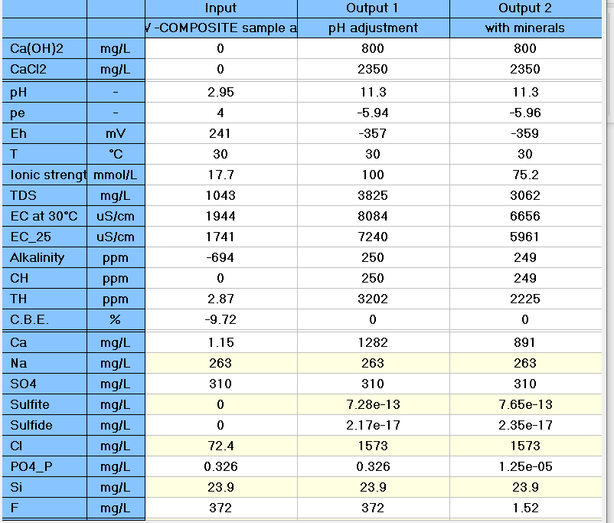
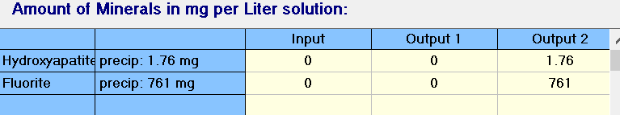
Hybrid (Lime +CaCl2) –Lab test vs simulation
Parameters | Units | Feed | Case 2
pH | - | 2.95 | 8.98
TDS | ppm | 1302 | 2656
EC | uS/cm | 2556 | 5029
Fluoride as F | ppm | 372 | 7.02
Sulphate as SO4 | ppm | 310 | 275
Phosphate as PO4 | ppm | <1 | <1
Chloride as Cl | ppm | 72.4 | 1443
Sodium as Na | ppm | 263 | 288
Calcium as Ca | ppm | 1.15 | 685
Silicon as Si | ppm | 23.9 | 2.88
Total Alkalinity as CaCO3 | ppm |  | 200

